Slide 1

MTO GROUP
HLTPAT005 Collect specimens for drugs of abuse testing
AS/NZS4308 & AS4760 Certified Drug & Alcohol Screening Officer Course

Slide 2
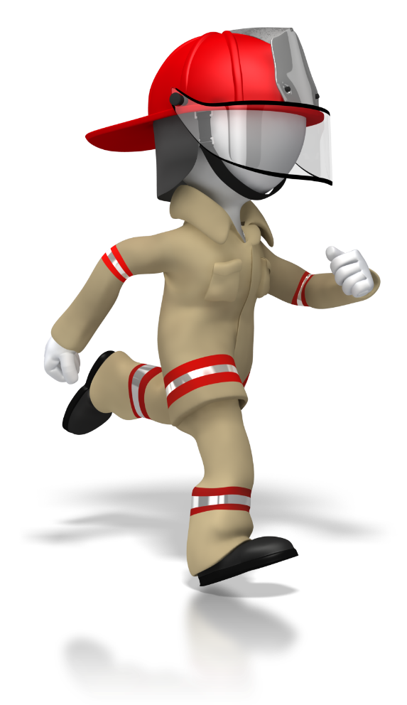
HOUSE KEEPING
EVACUATION
The Emergency Assembly Point is….
If it is necessary to evacuate this class, follow your Trainers instructions.
Walk & Please do not run.

Slide 3
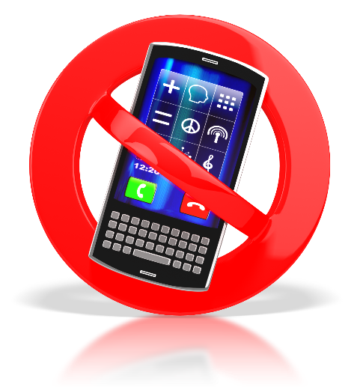

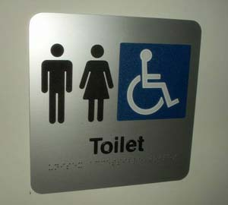
HOUSE KEEPING
Mobile phones on silent please
Tea and Coffee etc.
Bathrooms

Slide 4

INTRODUCTION
Your Trainer - Assessor for today is
Thomas Ball
Introduction Exercise
Find someone you do not know well
Interview each other (take notes) – 5 minutes each
Introduce this person to the rest of the class.

Slide 5

Australian Qualification Framework
This course is designed and delivered to AQF standards.
Your skills and knowledge will be assessed by a Cert IV TAE Qualified Assessor.
Our aim to help you succeed
You will be assessed as COMPETENT or NOT COMPETENT
You have the right to appeal or lodge a compliant

Slide 6

To Appeal or Lodge a Complaint
Speak to the trainer/assessor and explain your concern
Write to CEO of the MTO Group stating your concerns
Full contact details and procedures are in the front of your Trainee Work Book
http://www.asqa.gov.au/complaints/

Slide 7
This Course
Unit of Competency called:
HLTPAT005 Collect specimens for drugs of abuse testing
Assessment will be by:
A Written Knowledge Assessment
Three Practical Assessment Exercises
Questions or concerns me please ASK !

Slide 8

Acknowledgement
The MTO Group would like to acknowledge the help and assistance proved by DTBS Global Pty Ltd t/a Drug Testing Business Success in the development of this course

Slide 9
Course Outcome
Trainees who are assessed as competent on completion of this program meet the requirements of AS/NZS4308 & AS4760 Certified Drug & Alcohol Screening Officers Course.
Successful completion of this course will enable participants to conduct drug testing either as a “Collector” or “Technician”, as defined within the relevant standards.

Slide 10
Australian standards
This course is specifically concerned with the requirements of:
AS/NZS4308-2008 Procedures for specimen collection and quantitation of drugs of abuse in Urine
AS4760-2006 Procedures for specimen collection and quantitation of drugs in Oral fluid
Copies of these standards are available for purchase from: www.saiglobal.com

Slide 11
Cut- off levels & target concentrations
Urine Testing - Table 3.1 in AS/NZS 4308-2008
Class of Drug | Cut - off level ug/ L
Opiates | 300
Amphetamine Type substance | 300
Cannabis metabolites | 50
Cocaine metabolites | 300
Benzodiazepines | 200

Slide 12
Cut- off levels & target concentrations
Oral Fluids- Table 3.1 in AS 4760-2006
Class of Drug | Target levels ug/ mL
Opiates | 50
Amphetamine Type substance | 50
THC | 25
Cocaine and metabolites | 50

Slide 13
Workplace Health & Safety (WHS) relating to drug testing
WHS legislation and regulations (in most cases) do not have specific requirements relating to drugs and alcohol.
They do specifically require risks to be managed, eliminated or reduced wherever possible.
With the prevalence of drugs (including alcohol) in Australian society it is reasonable to always consider drugs and alcohol as risks to be managed in the workplace.

Slide 14
Drug types, effects & detection times
It is important to note that drug detection times in urine and oral fluid vary due to a variety of factors.
We have included detection times which are commonly observed in the field with on-site testing.

Slide 15
Amphetamine (AMP) ‐ may be legal
High doses of amphetamine lead to stimulation of the central nervous system inducing euphoria, alertness, reduced inhibition, a sense of increased energy, and reduced appetite.
Long term use responses include paranoia, hallucinations, psychotic behaviour and anxiety.
Detection times in the field
Oral Fluid: Up to 36 hours (some studies claim up to 72 hours)
Urine: Up to 3 days

Slide 16
Methamphetamines (MET or MAMP) Always illegal
Examples: Ice, speed, wizz (Ecstasy is sometimes included when drug testing within this class of drugs although it is technically another substance, MDMA).
Methamphetamines metabolise to Amphetamines. Effects are similar to Amphetamine but more pronounced.
Detection times in the field
Oral Fluid: Up to 36 hours (some studies claim up to 72 hours)
Urine: Up to 3 days

Slide 17
Cocaine (COC) – Always illegal
Examples: Coke, Crack, Charlie.
Synthesized and processed from the leaves of the Coca plant.
Cocaine is a potent central nervous system stimulant.
Detection times in the field
Oral Fluid: Up to 24 hours (Studies also claim 24 hours)
Urine: Up to 3 days

Slide 18
Marijuana (THC) – Always illegal
(Medical use may be permitted in some cases)
Examples: Joints, Hash, Weed.
THCΔ9‐tetrahydrocannabinol (Delta 9) is the main active ingredient in cannabis and the one which causes the “high” effect.
Long‐term effects may include behavioural changes, schizophrenia (although some studies conflict as to which comes first), diseases of the lungs and other organs.
Detection times in the field
Oral Fluid: Up to 12 hours (Some studies claim up to 14 hours)
Urine: Up to 6 weeks depending upon usage (metabolites can persist for months in chronic users).

Slide 19
Opiates (OPI)
Examples: Morphine, Codeine, Heroin
Opiate refers to any drug derived from opium poppy, including medicinal products such as morphine/codeine. Semi‐synthetic drugs derived from the opium poppy include heroin.
Long term effects include dependence and constipation.
Detection times in the field
Oral Fluid: Codeine up to 36 hours (Studies claim up to 48 hours for codeine). Morphine up to 36 hours (Studies agree up to 21 hours).
Urine: Up to 3 days

Slide 20
Benzodiazepines (BZO)
Examples: Diazepam, Nordiazepam, Oxazepam, Temazepam
Benzodiazepines are a class of psychoactive drugs that are typically prescribed for anxiety and sleep disorders.
Immediate effects include sedative and muscle relaxant outcomes.
Detection times in the field
Oral Fluid: Not included under current Australian Standards.
Urine: 1‐7 days

Slide 21
Topics covered in this course are:
Confirming specimen collection requirements
Preparing to collect the specimen
Collecting the specimen
Following post-collection procedures

Slide 22
1.0 Confirm collection requirements
Most collection candidates accept they must be drug tested as part of WHS.
Some are not likely to be overly happy they have been selected.
Some may even be openly hostile and resentful.
Drug & Alcohol Screening Officers should develop skills to effectively manage all candidates.
Anyone who does test positive is also likely to look for ways to avoid any kind of sanction.
Questioning the methods or processes is one way to cast doubt on the integrity of the sampling process or the individual collecting the specimen.
For this reason it is vital that the correct process and documentation is used.

Slide 23

It’s a people thing
Always introduce yourself and explain what your role is.
Always be polite and courteous, but not overly friendly or too familiar.
Don’t react to rude or aggressive behaviour.
Simply explain that you are there to do a job and its not personal in any way.
A polite and courteous greeting helps to create rapport and set the tone for your interaction with a collection candidate.

Slide 24
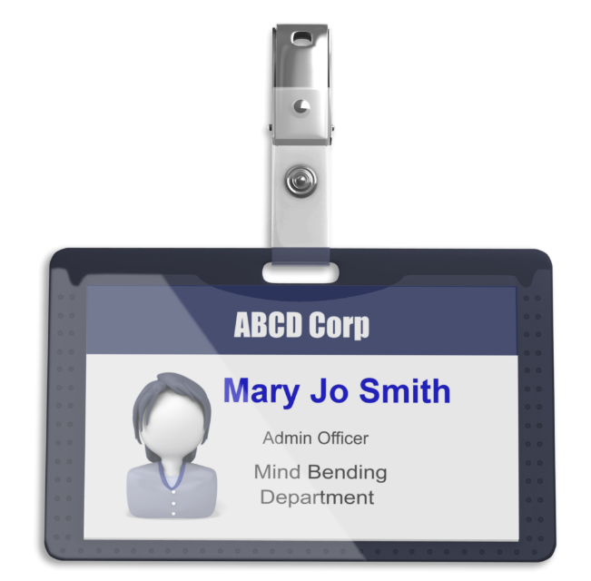
Have you got the right person?
Dependent on the client company’s policy or testing circumstances you may be required to:
Sight the Official Company (Photo ID).
Request an Official Photo form of ID (Drivers licence, Passport or similar).
Otherwise ensure you identify the person unequivocally.
This may include introduction to the collection candidate by a manager, supervisor, case manager or other suitable person.

Slide 25
Have you got the right person?
This identification requirement fulfils the donor identification requirements in the relevant Australian Standards.
If you are not satisfied that you have the correct person, do not proceed with specimen collection.
Inform the person nominated by the client organisation, or a senior person, of your concerns.

Slide 26
Is this the person nominated by the client?
Selection could be:
Totally at random
At fixed time intervals
Everyone as they enter a work site
After an accident or incident
On suspicion of using drugs of abuse
As part of a return to work program
As part of conditions relating to parole or for other corrections purposes

Slide 27
Is this the person nominated by the client?
Whatever the trigger for testing is, it is important the Drug & Alcohol Screening Officer confirms the person they are about to take a specimen from is the person nominated by the client organisation.
Pre-testing criteria may include:
The collection candidate’s advance acceptance / agreement to be subjected to drug testing as part of a work related role. This may be fulfilled as part of an induction process or work contract.
Internal procedures for a custodial scenario within the prisons or corrections environment.

Slide 28
Pre-testing questions
A set of pre-testing questions for the collection candidate or checklists for the Drug & Alcohol Screening Officer may be useful to establish:
Whether pre-testing criteria have been met in general.
Whether pre-testing procedures have been followed, such as the method used for selection of persons to be tested (in the case of random testing).
If there is any other reason why a collection candidate is not able to supply a specimen for testing.

Slide 29
Commence the recording of information
Once you are happy you have the right person and pre-testing criteria have been met you may proceed to next steps.
Official Documentation in the context of drug testing and the relevant Australian Standards is referred to as a “Permanent Record System”.
Your trainer / assessor will provide you with examples of the permanent record system to be adopted.
This may include a “testing record form” and chain of custody form as separate or combined documents.

Slide 30

Explain what is going to happen
Taking time to do this correctly is an important process as it will:
Ensure the person is properly informed.
Avoid potential accusations of incorrect process.
Do not rush this process and regularly stop to ask if they have any questions.
It may be useful to utilise scripts or checklists.

Slide 31
Consent for collection
It is now time to obtain consent to collect the specimen.
The procedure used for consent may include a written script or process to be verbally delivered to the collection candidate.
In most cases a written consent section will form part of the permanent record system / testing documentation in use.
Consent process may include clarifications the collection candidate fully understands the procedures about to occur.
Most importantly it must include specific consent for collection of a specimen (such as breath, urine or oral fluid) for the purposes of drug testing.

Slide 32
Consent is declined!
If the collection candidate refuses to consent, collection and drug testing cannot typically proceed.
You should aim to record the fact that the person has declined consent to collect a specimen on your paperwork / testing documentation.
As part of your pre-testing preparations it would be a good idea to establish the next steps in the event of consent refusal.

Slide 33
2.0 Prepare for collection procedure
In this section we cover:
Other preparation required prior to actual collection of the specimen.
Professionalism and the process followed here are just as important now as they are in the explanation and consent phase.

Slide 34
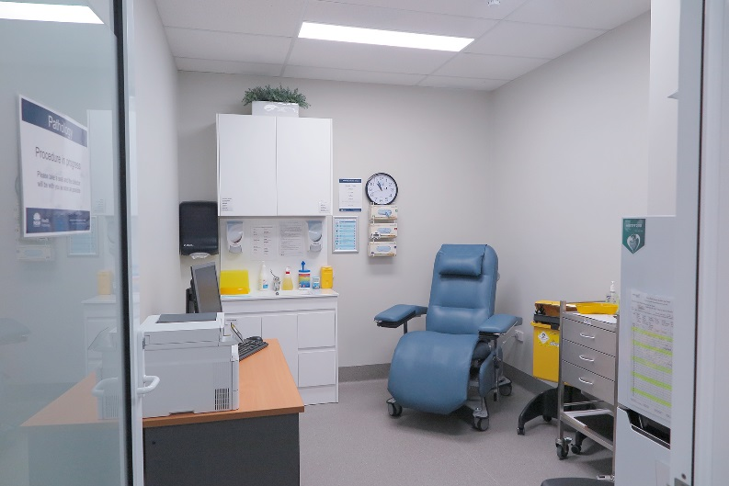
Prepare collection environment
Things you need to consider are:
Is this a clean safe environment?
Are there:
Tables
Chairs
Hand washing facilities
Hazardous waste (biological) disposal facilities (if required)

Slide 35
Prepare collection environment
Things you need to consider are:
A fridge to store specimens.
A cool transportation method for specimens you collect.
Is there a toilet or area where you can take a urine specimen?
Can you maintain the privacy and confidentiality of those you are taking a specimen from?
Its all about looking & behaving in a professional manner

Slide 36
Confirm collection method
Take care with this process because if you get this wrong the entire collection process can be compromised.
Things to consider are:
What is the drug testing specimen type, method of collection and equipment requirement?
Confirm the minimum quantity of specimen required and identify the equipment required.
Review and make sure you understand the correct documentation.
Check the manufacturer’s instructions.

Slide 37
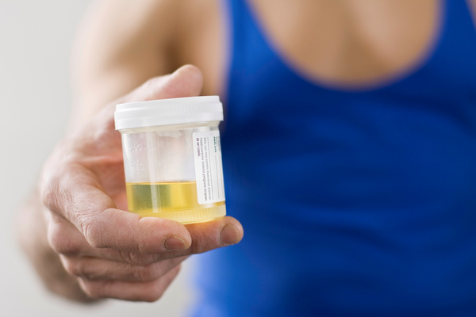
Prepare equipment
Do you have the necessary drug test kits ready for use?
Are they within expiry date?
Do you have all supporting equipment necessary
Do you have all the necessary testing documentation
One potential defence for a positive sample could be: “The sample kit was contaminated or had been tampered with prior to the specimen being taken.
One way to counter this is to have several identical sample kits on hand and ask the candidate to choose the kit they wish to be tested with.
Invite them to examine the kit and point out any unbroken seals or tamper proofing there may be in place.
Ask the client directly to confirm the kit is OK for them to use.

Slide 38
Offer client their choice of collection kit
One potential defence for a positive sample could be: “The sample kit was contaminated or had been tampered with prior to the specimen being taken.
Ask the candidate to choose their kit.
Invite them to examine the kit and point out any unbroken seals or tamper proofing there may be in place.
Ask the client directly to confirm the kit is OK for them to use.

Slide 39

Prepare client for collection procedure
Remove Excess Clothing
You need to strike a balance between the persons privacy and minimising their opportunity to conceal contaminants etc.
Store their property securely
Care also needs to be taken to make sure you collect and store candidate’s property in a safe and secure manner.
Lockers or sealed property bags are helpful.

Slide 40
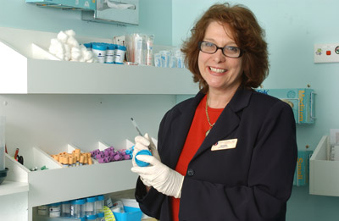
Answer questions from client
Questions may arise from collection candidates regarding drug testing collection and process including:
Why they are required to be drug tested?
What is going to happen during the procedure?
How the specimen is to be collected?
What will happen to the specimen after it is collected?
How long it is likely to take for a result to be known?

Slide 41
Answer questions from client
It is also likely the client may have other questions they want to ask:
You need to be prepared to answer any number of questions you might get asked.
You should do you best to answer truthfully and as accurately as possible.
DON’T be tempted to make up an answer or guess.
Beware of people who use multiple seemingly pointless questions as a delaying tactic.

Slide 42
Answer questions from client
If you suspect this is happening, you can simply call a halt to the process and refer them back to their employer or the referring body.
For you own protection you should make comprehensive notes on the situation and the types of questions you were asked.

Slide 43
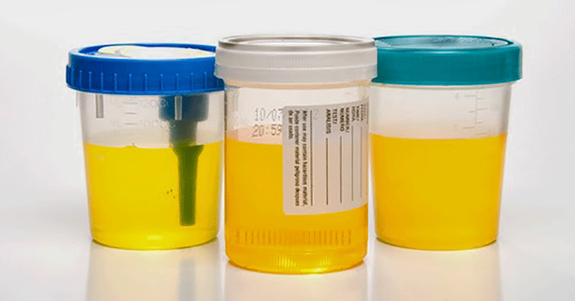
3.0 Collect specimen
After all your preparations, it is now time to collect your specimen.
Just as in the earlier sections, it is important this is done following the prescribed collection process very carefully.

Slide 44
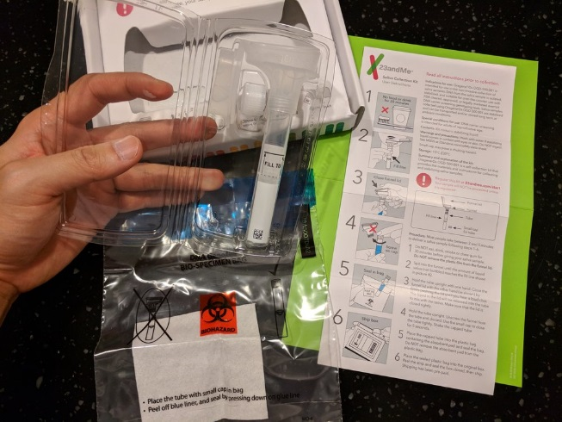
Follow sample collection procedure
Each manufacture of sample kits has their own specific procedures for the use of their products.
Please pay close attention to your Trainer/Assessor who will demonstrate the correct process for the sample kits on hand for this course.
Care is also required to follow any essential requirements of the Australian Standards or the protocols of any professional body or guidelines you are operating under.
Your Trainer / Assessor can clarify your specific requirements as part of the practical component of this course.

Slide 45
General details for urine test cups
Urine drug test cups are single use and disposable.
They typically are a plastic cup with a sealable lid and contain a set of test strips built into the cup.
Technology employed is referred to as lateral flow immunoassay.
The person being tested will provide a specimen of urine inside the cup to the required fluid level and reseal the cup.
Testing for adulterants and other specimen validity tests (SVT’s) may be included in urine cups.
Urine cups are temperature sensitive.
Urine drug test cups may be certified under AS/NZS 4308-2008.

Slide 46
General details for oral fluid test devices
Oral fluid drug test devices are single use and disposable.
They typically comprise of a collector absorbent pad or “swab” and test strips built into the device.
Technology again is lateral flow immunoassay although other technologies in development may be available in the near future.
Current oral fluid drug test devices from some manufacturers also include electronic systems which read test results from the consumable kit.
These types of kits are frequently used by police in Australia in part due to their ability to record results and generate test identification numbers.
The person being tested will place the collection swab in their mouth to collect oral fluid.

Slide 47
General details for oral fluid test devices
The collector will then place the swab into the collection chamber.
The test strips will automatically absorb the fluid and the test results will appear.
It is important to note that saliva is not classified as a biological fluid unless it is obtained from a dental procedure.
Oral fluid / saliva drug test kits are also temperature sensitive
AS4760-2006 specifications do not allow for certification of oral fluid drug test devices.
The oral fluid standard is under review as of 2017/2018 and certification of devices may soon be provided for.

Slide 48
Follow SOP for infection control
Specimen collection involves body fluids and care needs to be taken to protect all concerned from infections.
Simple steps to achieve safety can be taken such as:
Washing hands with an antibacterial agent (or soap) before and after each specimen is collected.
Dry hands carefully with hot air or disposable towels
Wear disposable rubber gloves during specimen collection and handling
Taking care to seal specimen containers as quickly as possible

Slide 49
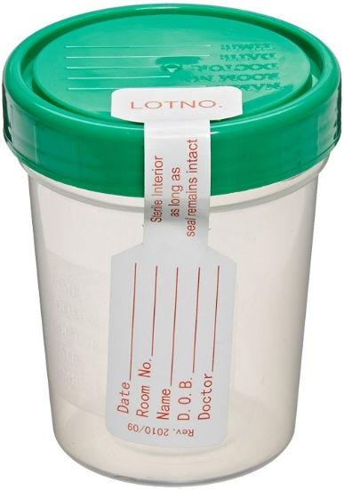
Watch out for sample tampering
Oral fluid / saliva samples are a fully observed collection which minimises risk of tampering.
Urine testing is most prone to tampering. Procedures should be adopted to remove this risk as far as possible.
The most common forms of tampering are:
Adding a contaminant to a sample
Attempting to dilute a sample
Substitution of a sample

Slide 50
Watch out for sample tampering
Things to watch out for are:
Person is taking an unusually long time to provide a urine specimen.
Suspicious rustling and sounds while providing a urine specimen.
People who appear to be chewing or sucking on something before or during a saliva sample.
Unwillingness to remove bulky clothing.

Slide 51
Watch out for sample tampering
Procedures should be adopted to not only minimise tampering risk but also to include action where tampering is suspected.
Options available may include:
Request the collection candidate provide a brand new sample.
Send the sample for which tampering is suspected to a laboratory for further analysis.
Conduct additional adulterant or specimen validity tests on-site where such equipment is on hand.

Slide 52
Validate (test) & secure sample
Once a specimen is collected and secured in its container it becomes the collector’s responsibility until it is dispatched to a laboratory for analysis.
At this point you need to:
Validate the specimen
Secure the specimen

Slide 53
Validate (test) & secure sample
Validating the sample: simply means checking that it is (as best you can tell) a genuine and complete specimen.
Some urine sample kits include built in specimen validity tests.
Separate equipment is also available to conduct further validity tests.
If this is possible you should follow their manufacturers’ instructions carefully.

Slide 54
Validating Urine Samples
Always check the temperature is within the expected range of 33ºC to 38ºC shortly after being voided from the body.
Check colour - If it looks like water and is at room temperature, then it probably is water.
Consider checking the creatinine level or conducting additional validity tests when in doubt.

Slide 55
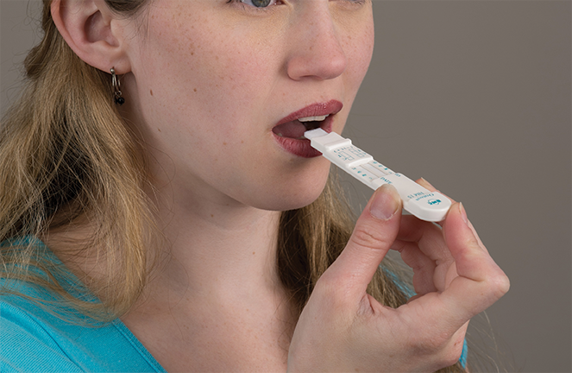
Validating Saliva Samples
Because a saliva specimen is fully observed during collection it is more difficult to tamper with or contaminate.
Because it requires only a small fluid sample it is less possible to dilute.

Slide 56
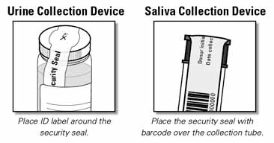
Securing the specimen
It is the collector’s responsibility to secure specimens and maintain their integrity.
This becomes most applicable following a non-negative or presumptive positive result.

Slide 57
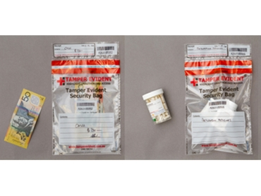
Securing the specimen
Security is normally achieved by:
Keep the specimens in view at all times during the initial on-site testing process.
Use of a chain of custody procedure including tamper evident seals and/or bags to seal specimens inside.
Keeping the specimens in a temperature-controlled environment prior to transport
Taking care with transport methods to a laboratory to maintain reasonable temperature control and security for samples.
Keeping the specimens in a secure location where unauthorised persons cannot tamper with them.

Slide 58
Temperature Breaches
If you suspect a temperature breach or the specimen’s integrity has been compromised in any way, it is better to report this early.
Better to retake specimens than to have compromised the pending laboratory analysis
Submitting a compromised specimen may void a laboratory result.

Slide 59
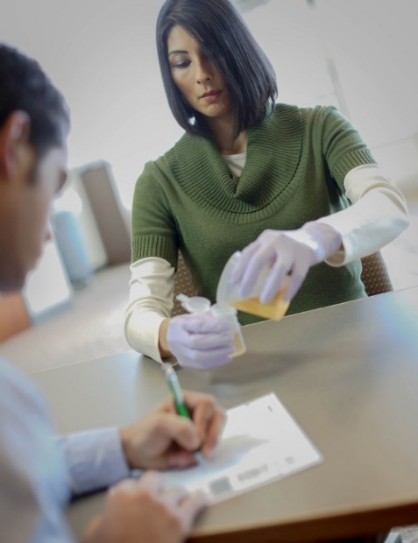
4.0 Follow post collection procedures
The next steps are all about:
Cleaning up
Checking all the specimens are correctly labelled where applicable
Following a chain of custody procedure and confirming sample security with the client
Preparing the specimen/s for transport to the laboratory

Slide 60
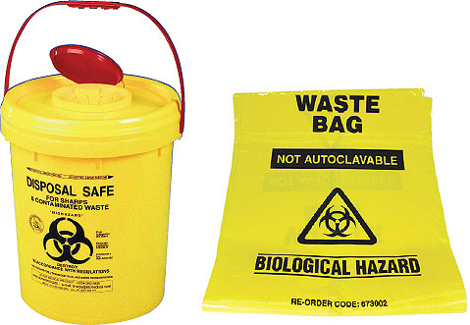
Follow infection control protocols
Typically, waste and clean up procedures will entail:
Donning rubber gloves (and possibly other PPE) where necessary.
Requesting clients dispose of urine into toilets and flush.
Collecting up waste and disposing of it in BioHazard bins or bags would be considered best practice.

Slide 61
Follow infection control protocols
Cleaning down work surfaces with an antibacterial agent.
Making sure the area is completely free of any unused sample kits.
Making sure no documentation of any kind is left behind.

Slide 62
Follow infection control protocols for waste disposal
Urine from a healthy human is pathogen free.
If a specimen contains a pathogen it must be disposed of at an approved medical waste facility.
Otherwise all test consumables may be disposed of in bags and ultimately via general waste unless State or Territory legislation dictates otherwise.

Slide 63
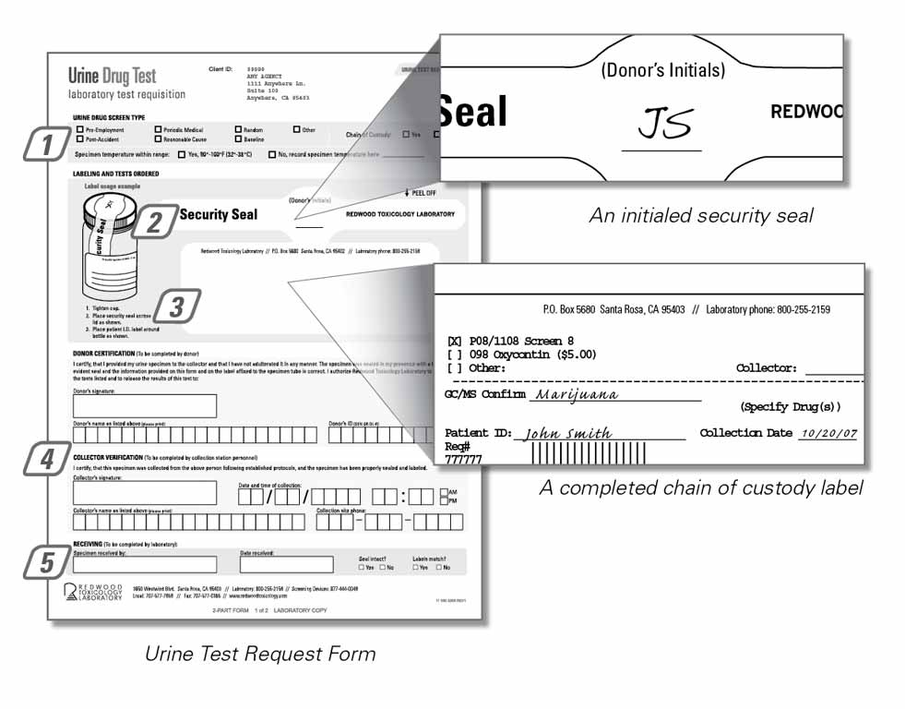
Label specimens to required standards
As a final step it is important that you check all specimens are correctly labelled and that all the required information is where it needs to be.
Each testing organisation or circumstance will have its own required process and you need to follow this without exception.

Slide 64
Confirm information and sample security
During the collection and post collection processes such as chain of custody you need to check:
The correct information is on the specimen and the paperwork.
A tamperproof seal is in place for specimen containers and if procedure requires, on the outer bag or box.
That both an A and B sample are sealed inside a tamperproof bag (if required)
Chain of custody / security of sample is a very important step to make sure there is no possibility of a specimen and its donor being mixed up.

Slide 65
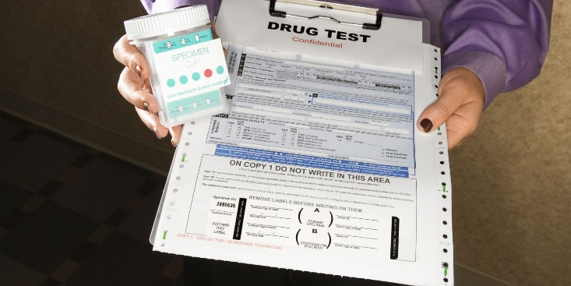
Drug testing documentation
Documentation should be prepared with consideration to the oral fluid and urine testing Australian Standards.
The Australian Standards refer to a ’permanent record system’. These may consist of a book or other system able to collect and store test records for each subject tested.

Slide 66
Drug testing documentation
Important features in such test records are confirmation of identity of the donor, Collector details, date of sample collection and consent. Records should be all in the sequence of collection.
Each organisation will have its own process and protocols for:
Recording details of what has been collected from whom.
What specimens have been sent to where, how and on what date etc.
General administration paperwork.

Slide 67
Drug testing documentation
It is the organisation who engaged you and your responsibility to:
Know and understand the documentation required
To complete and store that documentation in a safe and secure fashion.

Slide 68
Follow chain of custody procedures
The chain of custody is the chronological documentation or paper trail, showing the collection, transfer, receipt, analysis, storage, and disposal of the sample.
This ensures that any results reported relate beyond all reasonable doubt to a particular individual.
If the results should ever need to be used in court as evidence, the chain of custody records are fully defensible and can disprove any allegations of tampering or misconduct.

Slide 69
Chain of custody procedures require additional documentation and/or content.
There are two different approaches and both may demonstrate compliance with the guidelines:
Use a single document for all drug testing conducted. This would be a document which includes all necessary details for both permanent records of each test conducted and all chain of custody information for cases which require laboratory confirmation.
Use two documents. Firstly, a Test Record Form will record all necessary information as required by a “permanent record system” as outlined in the Australian Standards. Secondly, use of a separate chain of custody form in the case of laboratory confirmation being required.

Slide 70
Chain of Custody (COC)Documents
A physical chain of custody document is most often needed to accompany a sample to a laboratory for confirmation.
Note: A common practice within the industry has also been to include questions during the initial testing of donors regarding their recent use of drugs, alcohol and medications.
These questions are often included on the testing record documentation.
This type of information may be considered need to know only and may become relevant only following an initial non-negative / presumptive positive drug test result. At that time additional information can be more reasonably requested.
Medication can still be effectively risk managed without requiring usage details from every employee in the workplace.

Slide 71
Chain of Custody (COC)Documents
A COC document will follow and cover a specimen through:
Sample Preparation.
Analysis.
Reporting.
Confidence in the chain of custody.
By strictly following these processes and protocols it protects all parties.
Any suspected break in the chain of custody must be reported and acted on immediately.
Confidence the chain of custody has been maintained is fundamental to the integrity of all concerned.

Slide 72
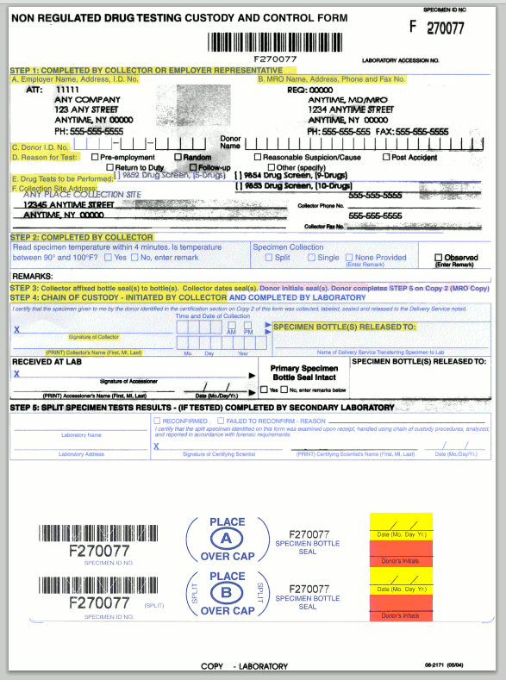
Sample COC Form

Slide 73
Storage of Samples
Australian Standards include recommended storage duration for samples held by a laboratory.
This caters for those occasions where a donor may request further testing of the “referee” sample to further verify a result. Such re-testing is rarely required.
Australian Standard AS 4760-2006 for oral fluid requires the laboratory to store referee samples frozen for 6 months, unless otherwise instructed in writing by a donor.
Australian Standard AS/NZS 4308:2008 for urine requirements are the same as above except 3 months and early disposal requires written authority of both the donor and the requesting authority.

Slide 74
Records of Testing
Australian Standard AS 4760 for oral fluid requires all testing records to be stored for 7 years in a secure location unless the requesting authority and donor make written agreement for earlier disposal.
Australian Standard AS 4308 for urine requirements are the same as above except only two years storage is required.
Records shall be kept in a secure location for a period consistent with the requesting authority's policy or as per National Pathology Accreditation Advisory Council (NPAAC) Guidelines or New Zealand equivalent.

Slide 75
NATA Accredited Laboratories
Laboratories can be accredited to the relevant Australian Standards for urine and oral fluid.
This quality accreditation process is certified via the National Association of Testing Authorities (NATA).
It is highly recommended only accredited laboratories be utilised for confirmation of results.

Slide 76
Assessment Time
Your Trainer/Assessor will now guide you through the knowledge and practical assessment process.
Thank you for you participating in this program.

